Slide 2
Chances are you already know that eating too much sugar isn’t good for you.
Are you overdoing it?
Americans average about 270 calories of sugar each day, that’s about 17 teaspoons (85 grams) a day. Recommendations for men are no more than 9 teaspoons/45 grams (~ 150 calories) of added sugar per day, and women should consume no more than 6 teaspoons/30 grams (~100 calories). One teaspoon is equal to about 5 grams.
Notes:
Chances are you already know that eating too much sugar isn’t good for you. Yet you’re probably still overdoing it. Americans average about 270 calories of sugar each day, that’s about 17 teaspoons a day. This compares to the recommended limits for men of no more than 9 teaspoons (36 grams or 150 calories) of added sugar per day. Women should consume no more than 6 teaspoons (25 grams or 150 calories).

Slide 3
Let's Clear Up Confusion
Sugary drinks, candy, baked goods, and sweetened dairy products are sources of added sugar, but so are breads, tomato sauce, and energy bars. Look for ingredients like corn syrup, agave nectar, palm sugar, cane juice, or sucrose.
No matter what it’s called, sugar is sugar.
Notes:
Sugary drinks, candy, baked goods, and sweetened dairy are the main sources of added sugar. But even savory foods, like breads, tomato sauce, and protein bars, can have sugar, making it all too easy to end up with a surplus of the sweet stuff. To complicate it further, added sugars can be hard to spot on nutrition labels since they can be listed under a number of names, such as corn syrup, agave nectar, palm sugar, cane juice, or sucrose.
No matter what it’s called, sugar is sugar, and in excess, it can negatively affect your body in many ways.
Although consuming small amounts now and then is perfectly healthy, you should try to cut back on sugar whenever possible.
Fortunately, simply focusing on eating whole, unprocessed foods automatically decreases the amount of sugar in your diet. In addition, keeping a food diary is an excellent way of becoming more aware of the main sources of sugar in your diet.
The best way to limit your added sugar intake is to prepare your own healthy meals at home and avoid buying foods and drinks that are high in added sugar.

Slide 4
Other Names for Added Sugar
According to the FDA, added sugars include sugars that are added during the processing of foods, foods packaged as sweeteners, sugars from syrups and honey, and sugars from concentrated fruit or vegetable juices. Added sugars do not include naturally occurring sugars that are found in milk, fruits, and vegetables. If these appear in the ingredients list of your favorite beverage, you are drinking a sugar-sweetened beverage.
Cane juice Corn syrup
Dextrose Fructose
Fruit juice concentrates Fruit nectars (such as agave nectar)
Glucose High fructose corn syrup
Honey Malt syrup
Maple syrup and syrup Molasses
Raw sugar Sugar
Sucrose Sugar cane

Slide 5
How Did Sugar Consumption Get So Out of Control
01
02
03
04
05
Beginning of mankind
1647
1700
1800
1900
Sugar industry took off.
Average sugar consumption is about 4 pounds per year
Consumption rose to 18 pounds per year
Average American consumption is 60 pounds per year
Sugar was not present.
Today, the average American consumes 150 -170 pounds of refined sugar per year. 30 pounds would be the average recommended level.
Notes:
It turns out that our collective sugar intake really is out of control. From 1977 to 2010, the average adult’s consumption of added sugars increased by more than 30 percent in the U.S., according to the Obesity Society. These days, the average person downs, per year, an estimated 152 pounds of sugar which is more than some individuals' entire body weight.
So how did we get to this point? Did we always have a sweet tooth? Sugar wasn’t even used at the beginning of mankind. In fact, the sugar industry did not take off until 1647. By 1700, the average consumption was about 4 pounds per year. By 1800, consumption rose to 18 pounds, and by 1900, it was up to 60 pounds. Today, the average American consumes between 150 and 170 pounds of refined sugars in one year. Try to visualize 30 to 34 five pound bags of sugar lined up next to each other. We’re talking ¼ to ½ pound of sugar each day!

Slide 6
Food Science Behind Sugar
We are born with a sweet tooth that makes us crave the breast milk needed to survive.
Manufacturers learn added sugars also increase appetite and override the satiety-regulating system.
Sugar is added to all kinds of foods, even foods that are not considered sweet like breads and condiments.
Food manufacturers learn that added sugars can make many foods tastier.
People consume significantly more sugar than they realize. Sugar and food consumption both increase.
Eating processed sugar triggers the release of opioids and dopamine in the brain, just like potentially addictive drugs do.
Notes:
What has happened that increased consumption so greatly? We are born with a sweet tooth. That craving helps ensure survival because newborns will be drawn to their mothers’ milk. Experts differentiate between the sugar in fruits, vegetables, and dairy products and the forms that are in our processed foods, believing the latter makes one crave more.
Once food manufacturers realized they could ignite the reward centers of our brains by adding sugar to processed foods, they started adding it to everything so you’d keep eating, says Pamela Peeke, a professor of medicine at the University of Maryland and author. Besides making that breakfast bar or frozen entree incredibly appealing while you’re eating it, the addition of processed sugar stimulates your appetite and overrides your body’s natural satiety-regulating system in a way that eating handfuls of snap peas or apple slices doesn’t.
“Consuming processed sugar has been found to cause a major rush of dopamine, which is the pleasure neurotransmitter,” Peeke explains. Having the reward response in your brain zoom off the charts this way makes you want to keep eating sugar to maintain that "high." Eventually, however, your brain becomes somewhat desensitized to sugar so you need more of it to achieve that same reward feeling. Researchers at Princeton University found that eating sugar triggers the release of opioids and dopamine in the brain, just like potentially addictive drugs do.
But it’s not the sugar in fruits, vegetables, dairy products and other whole foods that’s the problem, according to experts. It’s the stuff that’s added to processed foods, from soda, fruit drinks and fancy coffees to flavored yogurts, cereals, baked goods and candy. Sugar is even added to foods you may not expect to find it in, such as ketchup, salad dressings, pasta sauce, peanut butter and soups. Besides being a source of considerable calories that have no nutritional value, consuming processed sugars just makes you crave more.

Slide 7
All About Added Sugars
Added sugars are sugars that are added during the processing of foods, during preparation, or at the table. For example, sucrose or dextrose added during food processing is an added sugar, as is honey used to sweeten tea at your kitchen table.
Fortunately, “added sugars” are listed separately on Nutrition Facts panels underneath the line for “total sugars,” making it easier to determine whether or not your food contains any added sugars.
Notes:
What is added sugar?
Added sugars are sugars that are added during the processing of foods, during preparation, or at the table.
For example, sucrose or dextrose added during food processing is an added sugar, as is honey used to sweeten tea at your kitchen table.
Fortunately, “added sugars” are listed separately on Nutrition Facts panels underneath the line for “total sugars,” making it easier to determine whether or not your food contains any added sugars.

Slide 8
The sugars found naturally in fruit and dairy products don’t have the same negative effect and are lower in fructose than sugary processed foods. “In fruit, that sugar is bound up in the fiber, vitamins, and other nutrients,” says Andrea Dunn, a certified diabetes care and education specialist at the Cleveland Clinic.
Let’s be clear, there is a big difference between eating an orange and drinking a glass of orange juice.
Notes:
Naturally occurring sugars aren’t the enemy!
The sugars found naturally in fruit and dairy products don’t have the same negative effect and are lower in fructose than sugary processed foods. “In fruit, that sugar is bound up in the fiber, vitamins, and other nutrients,” says Andrea Dunn, a certified diabetes care and education specialist at the Cleveland Clinic Section of Nutrition Therapy. “And because the sugar is digested along with the fiber, it’s absorbed into the body more slowly.” That means you don’t get the same spikes in blood sugar and insulin that you do after eating a food with added sugars. Let’s be clear, there is a big difference between eating an orange and drinking a glass of orange juice.

Slide 9
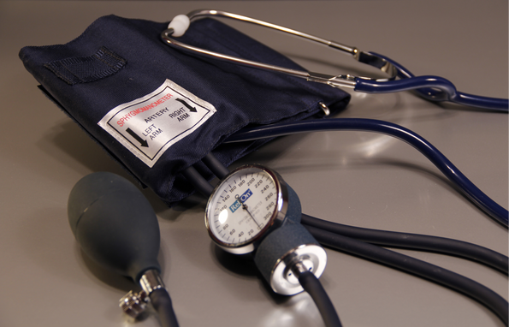
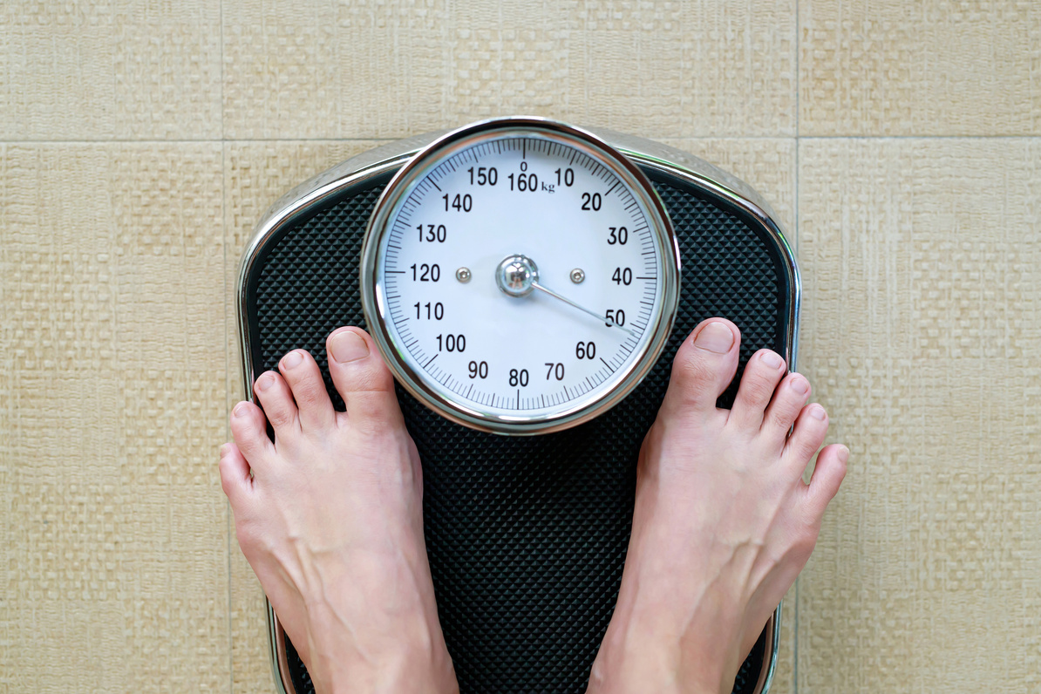
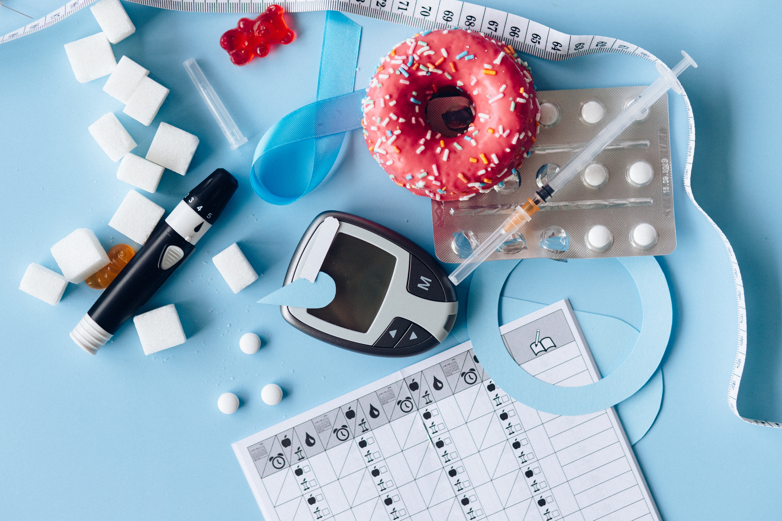
Excess Sugar Leads to Health Issues
High Blood Pressure
Heart Disease
Brain
Weight Gain
Diabetes Risk
Aging Skin
Notes:
No matter what it’s called, sugar is sugar, and in excess, it can negatively affect your body in many ways.
Consuming too much added sugar can raise blood pressure and increase chronic inflammation both of which are pathological pathways to heart disease. Excess consumption of sugar, especially in sugary beverages, also contributes to weight gain by tricking your body into turning off its appetite-control system because liquid calories are not as satisfying as calories from solid foods. This is why it is easier for people to add more calories to their regular diet when consuming sugary beverages.

Slide 10
High Blood Pressure
The force of blood pushing against the wall of the blood vessels
Changes to blood sugar levels have a larger impact on blood pressure than consuming salt. Excessive added sugars, especially high fructose corn syrup, lead to increased inflammation in the body.
Replace processed foods with whole foods such as fruits, vegetables, and whole grains.
Notes:
Changes to blood sugar levels have a larger impact on blood pressure than consuming salt. Excessive amounts of added sugars increase inflammation in the body. Especially consuming high fructose corn syrup. Be sure to consume whole foods such as fruits, vegetables, and whole grains to replace sugar

Slide 11
Heart Disease
Eating less sugar can help lower blood pressure, a major risk factor for heart disease.
When you eat or drink too much sugar, the extra insulin in your bloodstream can affect the arteries all over your body. It causes their walls to get stiff and inflamed.
This puts stress on your heart which may lead to heart attacks or heart failure.
Notes:
Research also suggests that eating less sugar can help lower blood pressure, a major risk factor for heart disease. Plus, people who eat a lot of added sugar (where at least 25% of their calories comes from added sugar) are twice as likely to die of heart disease as those whose diets include less than 10% of total calories from added sugar.

Slide 12
How Does this Impact Your Brain?
Brain releases feel good chemical called Dopamine
Consuming sugar will give you a burst of energy due to rapid raising blood sugar.
Too much sugar may lead to increased risk of depression in adults
When sugar is consumed in excess, the brain begins to crave sugar more frequently.
Ultimately, it impacts mood by leading to a mid day "slump."
Opt for the consumption of whole fruits and vegetables as they don't release as much dopamine.
Notes:
Eating sugar gives your brain a huge surge of a feel-good chemical called dopamine. That explains why you’re more likely to crave a candy bar at 3 p.m. than an apple or a carrot.
Because whole foods like fruits and veggies don’t cause the brain to release as much dopamine, your brain starts to need more and more sugar to get that same feeling of pleasure. This causes those “gotta-have-it” feelings for your after-dinner ice cream that are so hard to tame
The occasional candy or cookie can give you a quick burst of energy (or “sugar high”) by raising your blood sugar levels fast. When your levels drop as your cells absorb the sugar, you may feel jittery and anxious (a.k.a. the dreaded “sugar crash”).
But if you’re reaching into the candy jar too often, sugar starts to have an effect on your mood beyond that 3 p.m. slump: Studies have linked a high sugar intake to a greater risk of depression in adults.

Slide 13
Excess Sugar => Weight Gain
Consuming sugary beverages is associated with weight gain and increased risk of Type 2 Diabetes. Excessive fructose consumption may cause resistance to Leptin, an important hormone that regulates hunger and tells your body to stop eating.
Notes:
Obesity rates are rising worldwide, and evidence suggests that added sugar — often from sugar-sweetened beverages — is a major contributor to obesity.
Sugar-sweetened drinks like soda, juices, and sweet teas are loaded with fructose, a type of simple sugar. Consuming fructose increases your hunger and desire for food more than glucose, the main type of sugar found in starchy foods.
Additionally, animal studies show that excessive fructose consumption may cause resistance to leptin, an important hormone that regulates hunger and tells your body to stop eating. In other words, sugary beverages don’t curb your hunger, making it easy to quickly consume a high number of liquid calories. This can lead to weight gain.
Research shows that consuming sugary beverages is associated with weight gain and increased risk of type 2 diabetes.

Slide 14
Increased Risk for Type 2 Diabetes
Diabetes is a leading cause of mortality and reduced life expectancy.
Excessive sugar consumption has been associated with an increased risk of Diabetes. Eating large amounts of sugar can indirectly raise Diabetes risk by contributing to weight gain and increased body fat — both are risks for developing Diabetes.
Notes:
Diabetes is a leading cause of mortality and reduced life expectancy. Its prevalence has more than doubled over the past 30 years, and projections estimate its burden will continue to rise.
Excessive sugar consumption has been historically associated with an increased risk of diabetes. Eating large amounts of sugar can indirectly raise diabetes risk by contributing to weight gain and increased body fat — both of which are risks for developing diabetes.
Obesity, which is often caused by excessive sugar consumption, is considered the strongest risk factor for diabetes. What’s more, prolonged high-sugar consumption drives resistance to insulin, a hormone produced by the pancreas that regulates blood sugar levels.
Insulin resistance causes blood sugar levels to rise and strongly increases your risk of diabetes. Additionally, research has found that people who drink sugar-sweetened beverages are more likely to develop diabetes.
A study including individuals who drank sugary beverages for over a 4-year period found that increased consumption of sugary beverages — including soft drinks and 100% fruit juice — is associated with a higher risk for type 2 diabetes

Slide 15
Aging Skin
Wrinkles are a natural sign of skin aging. However, poor food choices can worsen wrinkles and speed up the skin aging process.
Consuming a diet high in refined carbs and sugar may cause your skin to age prematurely.
Notes:
Wrinkles are a natural sign of skin aging. They appear eventually, regardless of your health. However, poor food choices can worsen wrinkles and speed up the skin aging process.
Advanced glycation products (AGEs) are compounds formed by reactions between sugar and protein in your body. They are suspected to play a key role in skin aging. Consuming a diet high in refined carbs and sugar leads to the production of AGEs, which may cause your skin to age prematurely.
AGEs damage collagen and elastin, which are proteins that help the skin stretch and- keep its youthful appearance. When collagen and elastin become damaged, the skin loses its firmness and begins to sag.

Slide 16
Cutting Sugar Can Improve Health
The USDA recommends limiting added sugars to less than 10% of your daily calories. Meanwhile, the American Heart Association recommends no more than 6 teaspoons/30 grams (100 calories) of added sugar for women and 9 teaspoons/45 grams (150 calories) for men. (Currently, adults are generally consuming nearly 17 teaspoons/85 grams).
How can YOU cut back on your sugar intake?
Notes:
Deciding to cut back on your added sugar intake is no easy task. After all, it can hide in many different foods and beverages—even the so-called "healthy" ones. Although sugar isn't considered to be a healthy food, a little sweetness is OK.
The U.S. Department of Agriculture recommends limiting added sugars to less than 10% of your daily calories. Meanwhile, the American Heart Association recommends no more than 6 teaspoons (100 calories) of added sugar for women and 9 teaspoons (150 calories) for men. (As a daily average, adults are consuming nearly 17 teaspoons).
It's important to note that these recommendations don't include naturally occurring sugars found in whole foods, such as fruit or milk. Your body spends more time digesting whole foods and processing their sugars.

Slide 17
Target Your Weaknesses
In the U.S., most added sugar comes from the following five sources: sweetened beverages; desserts and sweet snacks; sweetened coffees and teas; candy and other sugars (jams, syrups, toppings); and breakfast cereals and granola bars. Figure out which category you tend to get the most added sugar from and start cutting back there. You'll get the greatest reduction in overall sugar and boost in health benefits. (Eating Well, 15 Ways to Eat Less Sugar, August 2021)
Notes:
In the U.S., most added sugar comes from the following five sources: sweetened beverages; desserts and sweet snacks; sweetened coffees and teas; candy and other sugars (jams, syrups, toppings); and breakfast cereals and granola bars. Figure out which category you tend to get the most added sugar from and start cutting back there. You'll get the greatest reduction in overall sugar and boost in health benefits

Slide 18
Aim for High Quality Carbs
Many packaged products—tortillas, granola bars—fall into a nutritional gray zone. They may be made with whole grains (good) and still contain lots of sugar (not so good). Even a product with "no added sugars" can be questionable if it replaces sugar with refined starches that have no fiber and affect your body similarly to added sugars. Evaluate overall carb quality, not just sugar content.
One simple way to do that: use the 10-to-1 metric. This means for every 10 grams of total carbohydrate that a product contains, 1 gram or more should be fiber.
Notes:
Many packaged products—tortillas, granola bars—fall into a nutritional gray zone. They may be made with whole grains (good) and still contain lots of sugar (not so good). Even more stealthily, the front of the package may declare "no added sugars," but the manufacturer has replaced this nutrient with something else, such as refined starches that have no fiber and affect your body in ways similar to added sugars. "So it's important to assess overall carb quality, not just sugar alone,"

Slide 19
Don't Drink Your Sugar
Soda is full of sugar, but other drinks may slip past your nutritional radar. Coffee drinks can have 34 grams of added sugar, and one 20-ounce sports drink packs as much as 48 grams—which is just about 100% of your daily limit. (For comparison, a can of Coke has 39 grams.) Juices and smoothies are also usually made with added sugar. Sweetened drinks are the largest source of added sugars. Swap out one sweetened beverage a day for water (even infuse it with fruit) or flavored seltzer.
Notes:
"Sports drinks serve a purpose for elite athletes, or let's face it, when we're sick with the flu or prepping for a colonoscopy. But for everyone else, just choose water," says Nancy Farrell Allen, M.S., RDN, a national spokesperson for the Academy of Nutrition and Dietetics. And let's not forget cocktails. Alcohol itself contains no or very little sugar, but when you add the coffee liqueur to your 'tini—that's when the grams can go through the roof.
By eliminating even one sugary beverage a day and instead sipping water with a squeeze of lime or orange for flavor, you can dramatically reduce your sugar intake—especially given that sweetened beverages are the single largest source of added sugar in the American diet, says Micha. You could also try drinking seltzer in fun flavors, infusing your water with fresh fruit or eating an apple or orange alongside a glass of ice water. We love the Strawberry, Basil & Lime Infused Water pictured above.

Slide 20
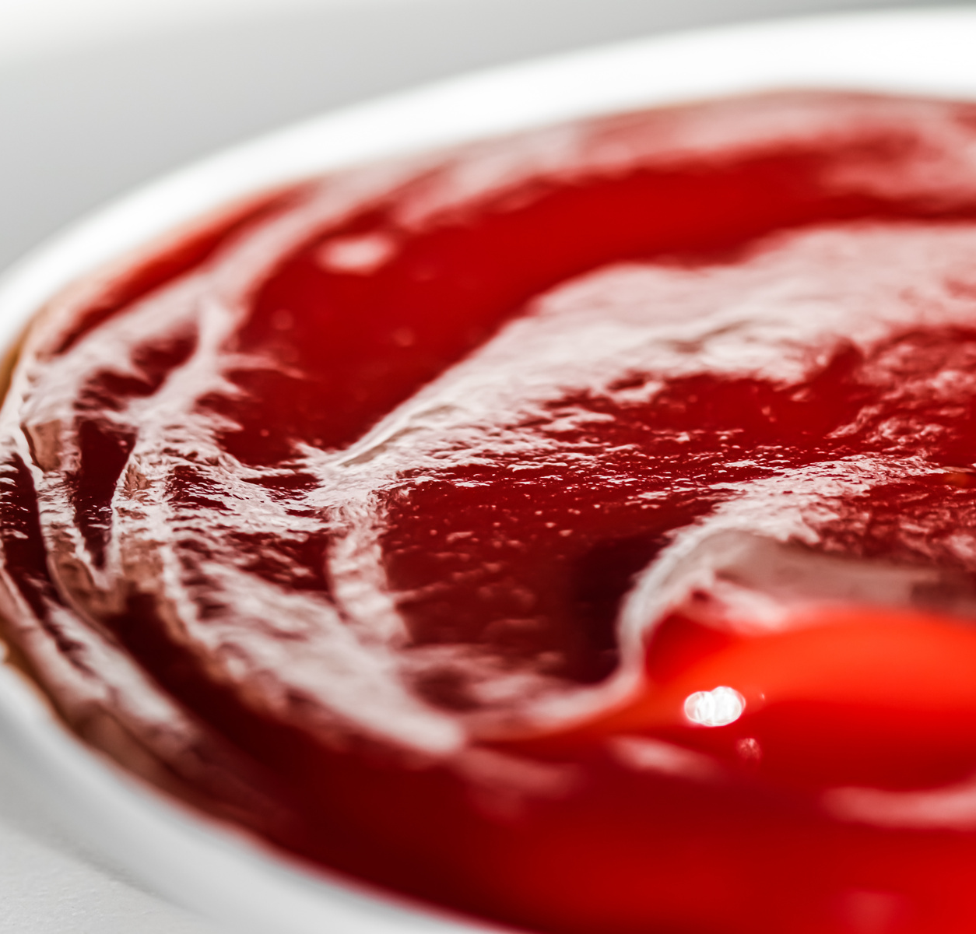
Condiments, sauces, and dressings
Processed, packaged, or frozen foods
Watch Out for Sneaky Sources of Sugar
Sugar isn't just added to make foods taste better--it is also a preservative that extends shelf life. It makes pastries tender and helps breads to rise. This is why food manufacturers add sugar not just to traditionally sweet foods, but to tons of savory ones as well.
Another reason to read and compare labels!
Soups and broths
Notes:
Other things to consider: plant-based milks have added sugar (unless they are unsweetened). Kombucha also can be high in added sugars.
Wine
All grapes contain natural sugars. To make wine, the added yeast needs that natural sugar to eat and then ferment. Any sugar that remains after fermentation is called residual sugar. "But also winemakers sometimes add sugar if the grapes aren't ripe enough, and that may be more common in colder regions, such as Oregon, Bordeaux and Burgundy," explains Blatner. Because wines do not have to have nutrition labels, it is difficult to tell how much residual sugar is in a wine or how much sugar has been added. So how can you find out how much sugar is in your wine? "Cheaper wines may have added sugar, but here's a top tip: Some wineries have tech sheets on their websites that list residual sugar (RS) amounts," says Blatner.

Slide 21
Gradually Reduce Sugar
Be sure to reduce your sugar intake slowly to make it easier on yourself. Try reducing sugar by 5 to 20% every week—equivalent to deleting about 20 to 60 teaspoons or 4 to 12 grams a day. This will give you some time to allow your perception of sweetness to change.
Notes:
It is recommended to wean yourself off sweetness slowly. Do you add sugar to your coffee or tea? Then use a little less tomorrow. A few days later, dial it back a bit more. Studies show that reducing sugar by 5 to 20%—equivalent to deleting about 4 to 12 grams daily—is not noticeable, and that over time your perception of sweetness intensity changes. In one trial, people who limited their sugar intake for 2 to 3 months rated pudding as much sweeter than those who did not.

Slide 22
Get Enough Sleep
The average adult needs between 7 and 9 hours a night—yet more than 35% of Americans get less than that. Missing out on sleep can increase your hunger hormones, making you crave sugary foods.
Notes:
The average adult needs between 7 and 9 hours a night—yet more than 35% of Americans get less than that. Missing out on sleep can monkey with your hunger hormones, making you crave sugary foods (and salty ones too). However, in a review of seven clinical studies published in the Journal of Sleep Research, participants who increased their sleep duration—by anywhere from 21 minutes to 3 hours a night—had better insulin sensitivity as well as reductions in appetite, sweet cravings and sugar intake.

Slide 23
5 More Ways to Cut Back
01
02
03
04
05
Know how much you consume
Start reading labels
Roast your veggies
Add your own
Rethink recipes
Buy unsweetened products and add your own sugar to control how much sugar is added
Sugar sneaks into "healthy foods," so be sure to know sugar has many names
Rather than sautéing your veggies and adding dressings, try to roast them and caramelize the natural sugars.
Experiment with using less sugar than the recipe suggests. Limiting sugar helps your palate adjust
Determine your average daily consumption and try cutting out one item a week. This will help your overall intake

Slide 24
WEB RESOURCES
How Does Too Much Sugar Affect Your Body? (www.webmd.com)
The Bitter Truth About Too Much Sugar (www.aarp.org)
11 Reasons Why Too Much Sugar is Bad for You (www.healthline.com)
Get the Facts: Added Sugars (www.cdc.gov)
How Much Sugar is in Popular Drinks? (www.thediabetescouncil.com)
Virginia Foundation for Healthy Youth Rev Your Bev (www.revyourbev.com)
Connect with us on social media at CommonHealthVA

